Slide 1
2122 Autumn/Winter

Slide 2
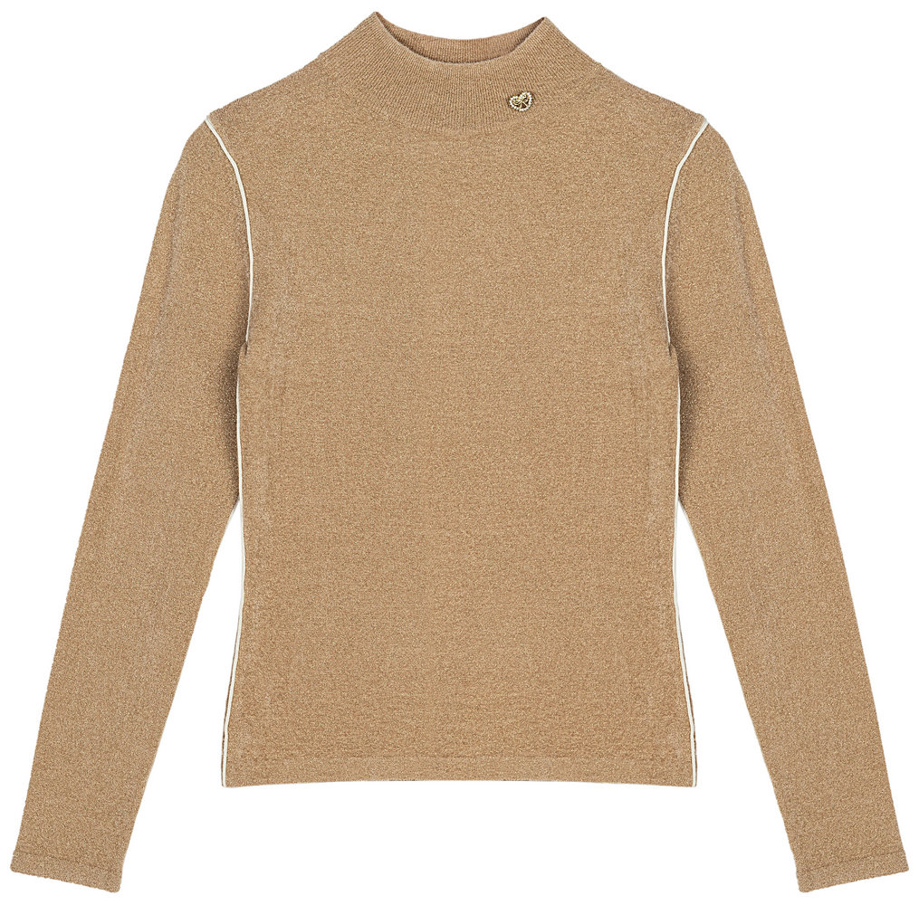
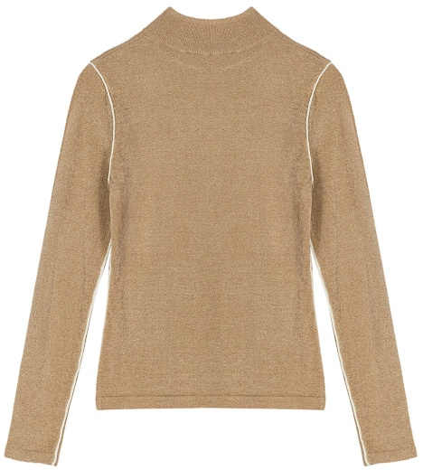
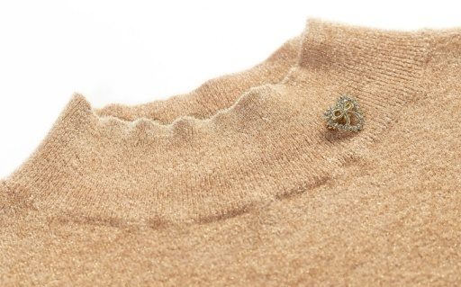
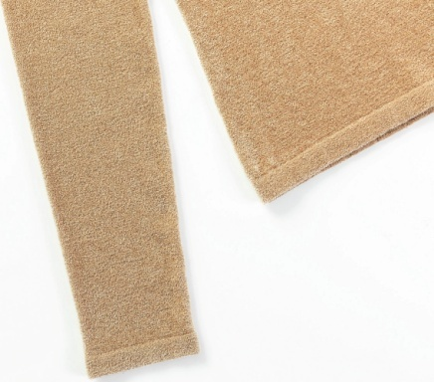
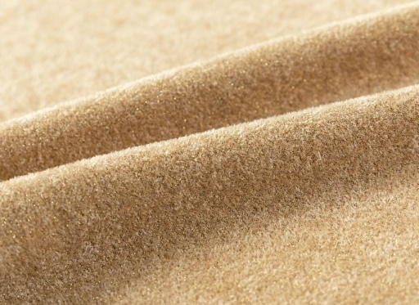
NEEDLES & STITCHES
Gauge:14GG
Yarn:1/27 44%NYLON 42%VISCOSE 14%LUREX
+2/48 100%WOOL
Weight:145g
STYLE NO：21121

Slide 3
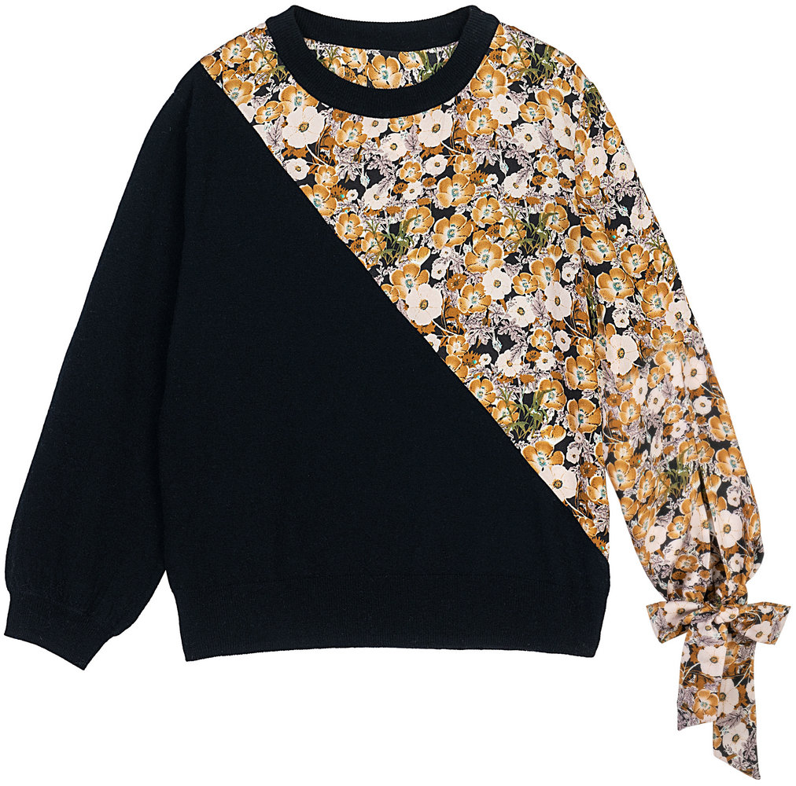
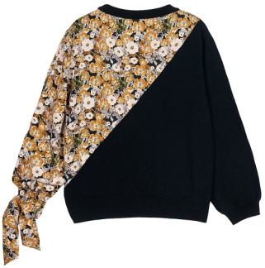
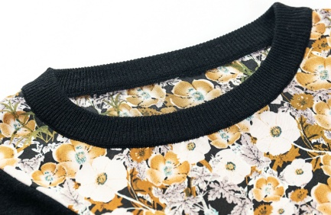
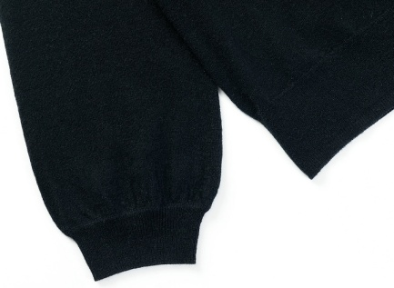
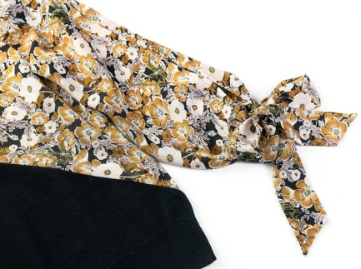
NEEDLES & STITCHES
Gauge:14GG
Yarn: 2/48 70%WOOL 30%CASHMERE
Weight:91g
STYLE NO：21105

Slide 4
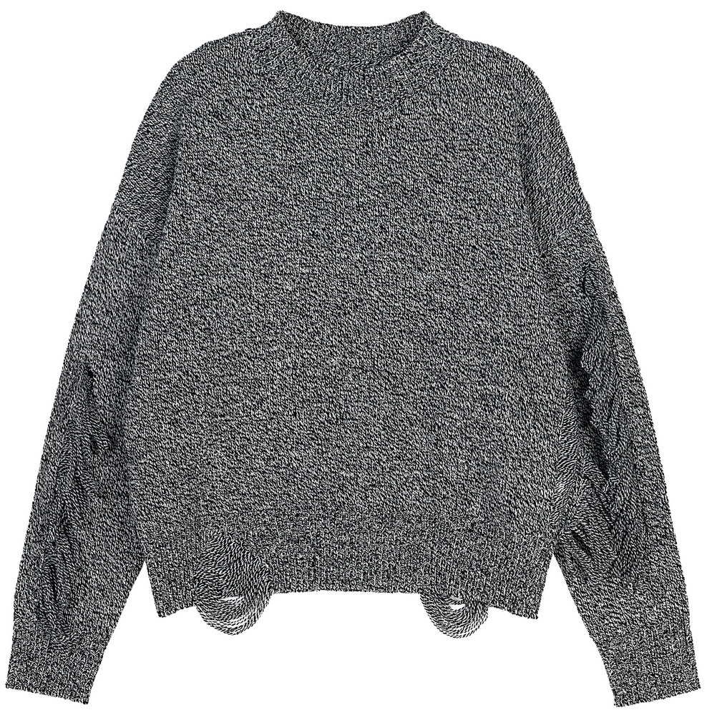
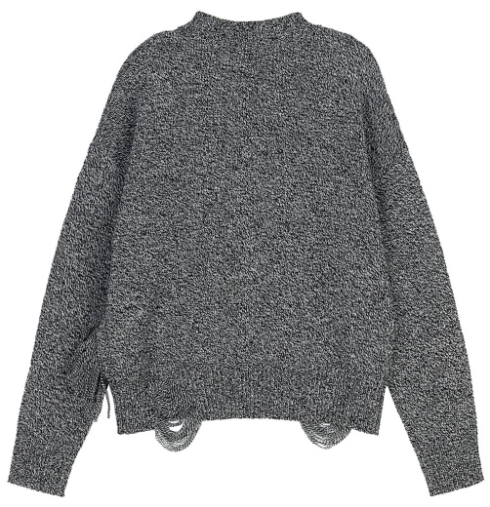
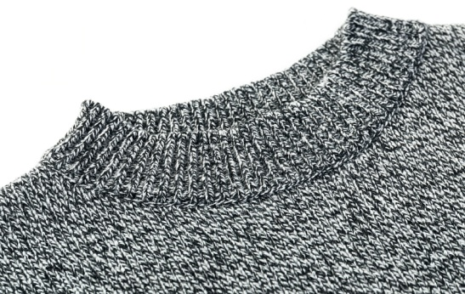
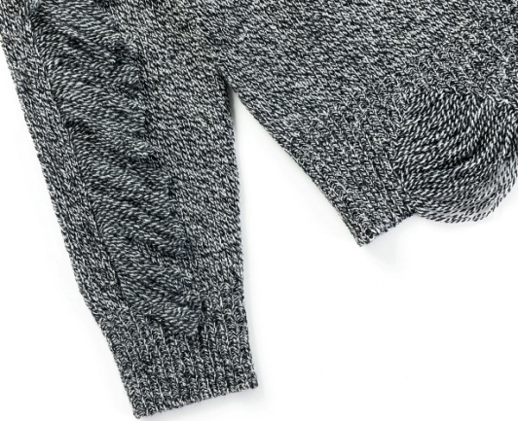
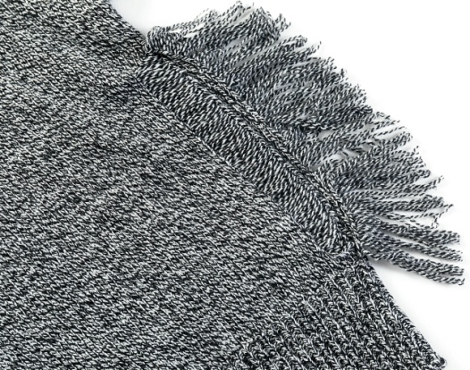
NEEDLES & STITCHES
Gauge:5GG
Yarn: 2/17.5 100%WOOL
Weight:335g
STYLE NO：21082

Slide 5
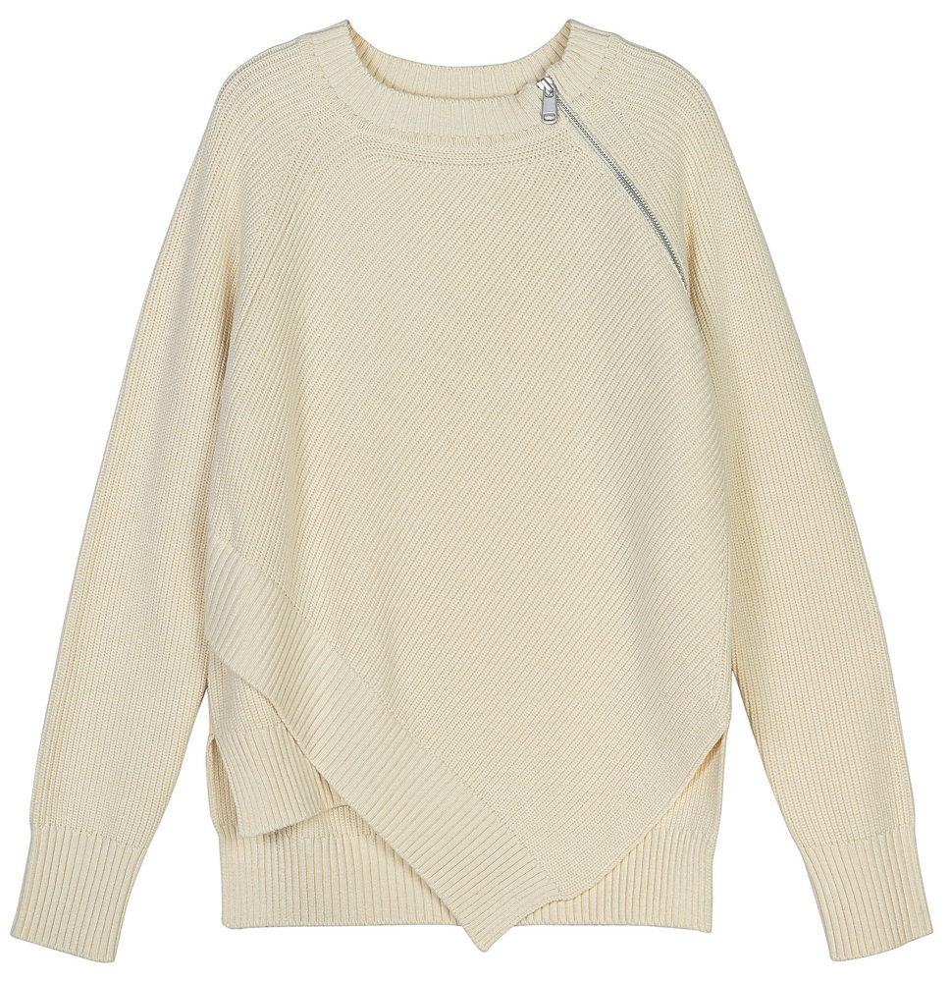
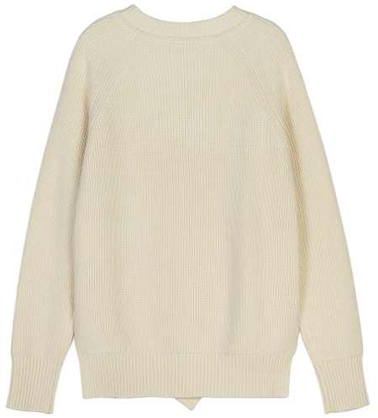
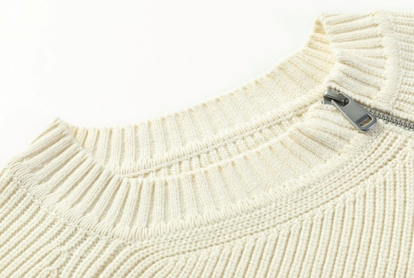
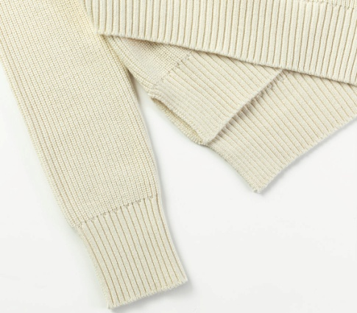
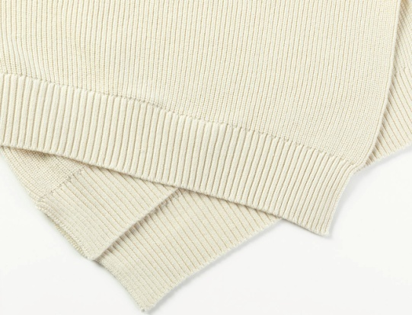
NEEDLES & STITCHES
Gauge:7GG
Yarn: 2/28 38%COTTON 31%VISCOSE 20%NYLON 11%WOOL
Weight:654g
STYLE NO：21084

Slide 6
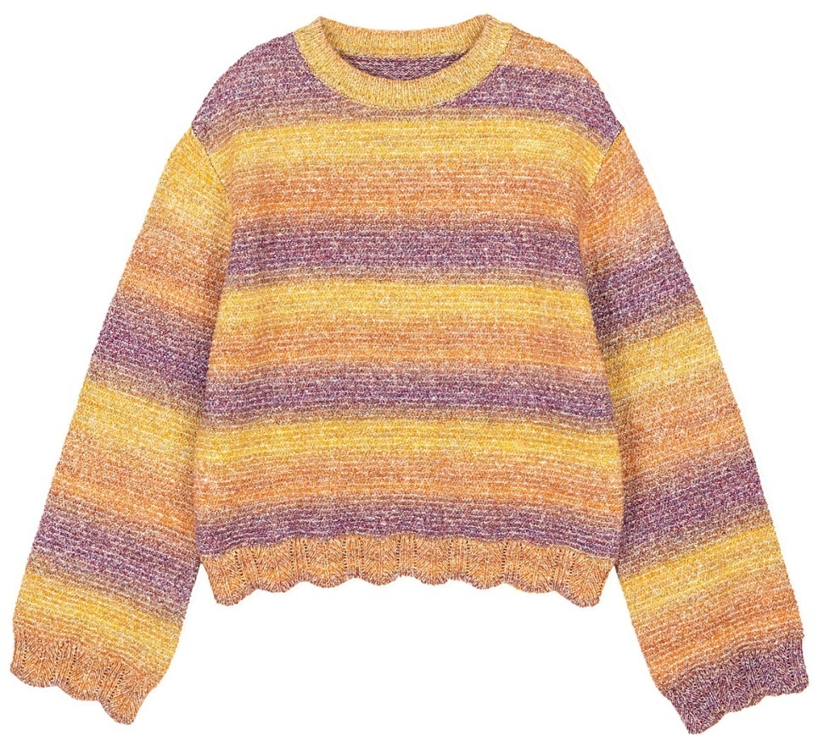
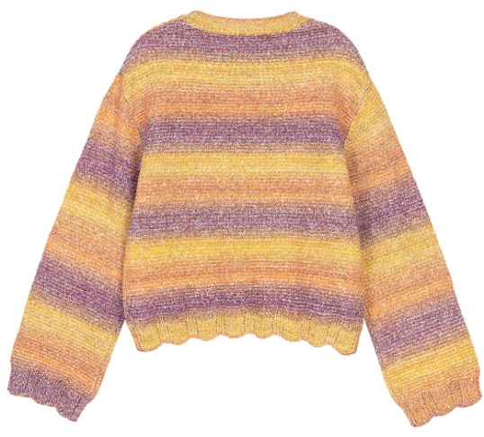
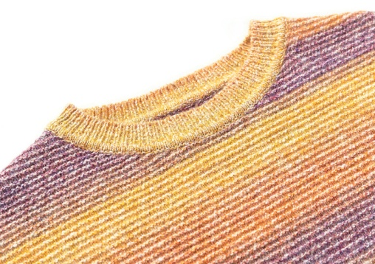
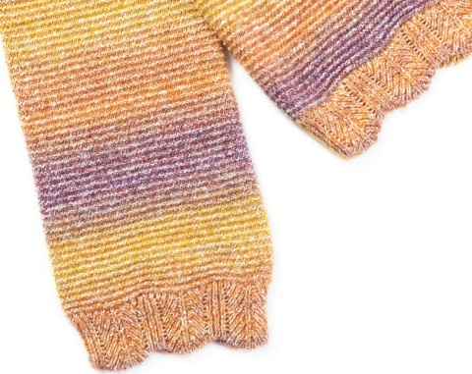
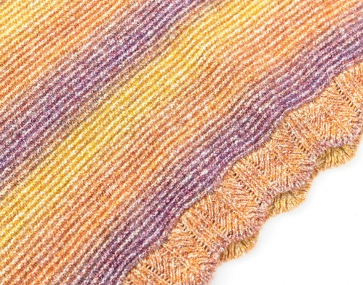
NEEDLES & STITCHES
Gauge:5GG
Yarn: 1/5.5 36%COTTON 29%ACRYLIC 25%RECYCLED COTTON 10%POLYESTER
Weight:313g
STYLE NO：21096

Slide 7
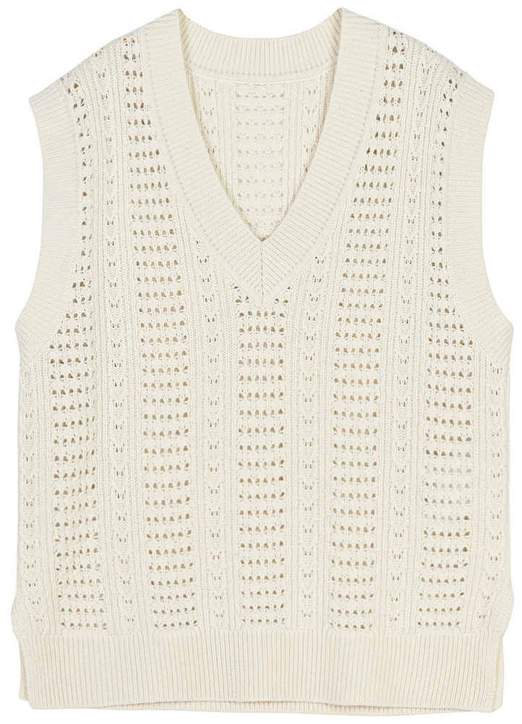
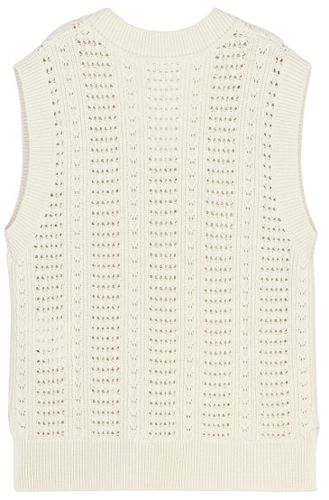
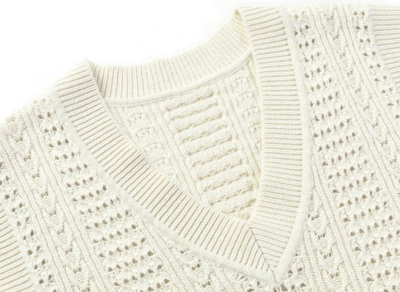
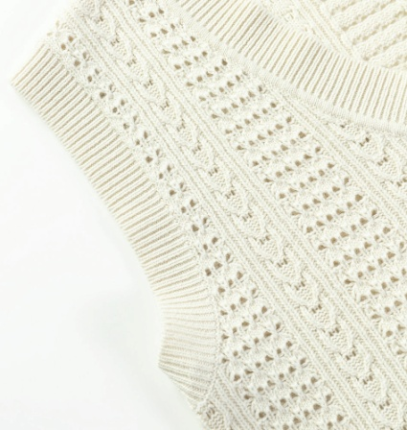
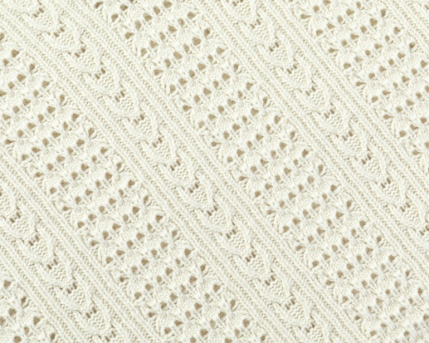
NEEDLES & STITCHES
Gauge:5GG
Yarn: 2/26 90%WOOL 10%CASHMERE
Weight:381g
STYLE NO：21100

Slide 8
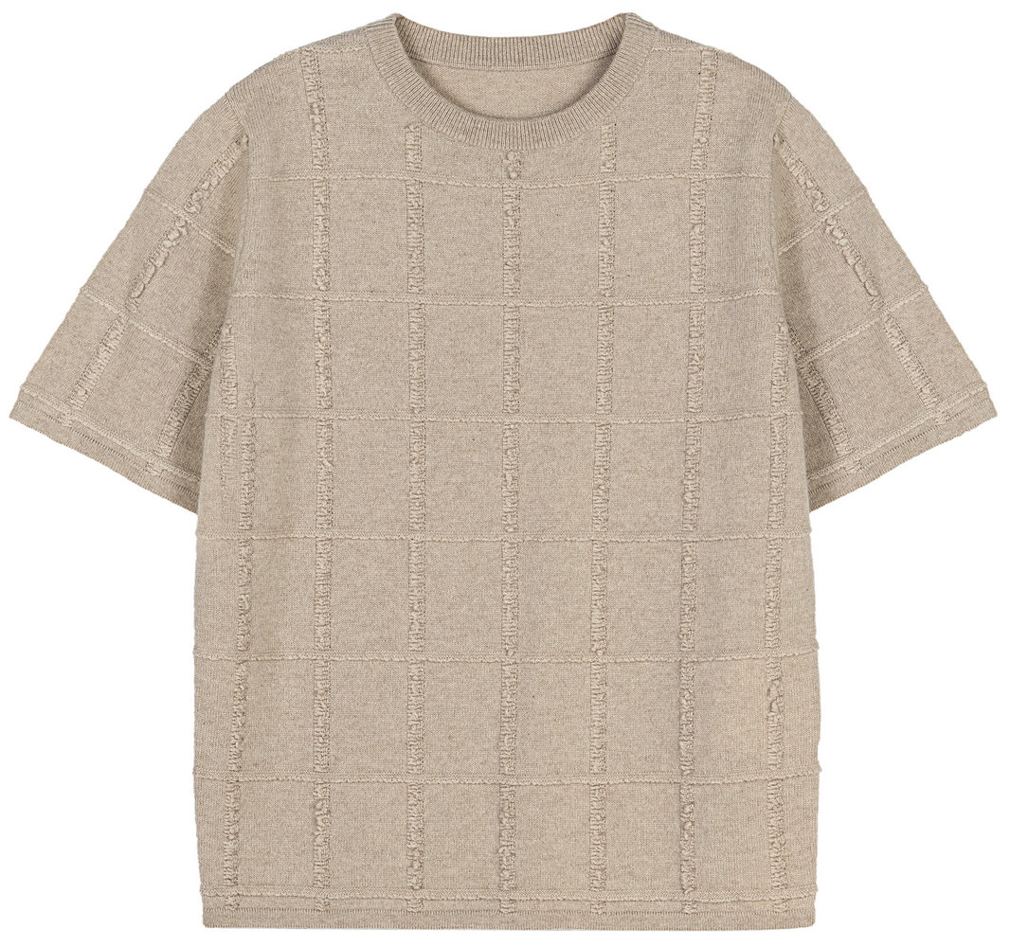
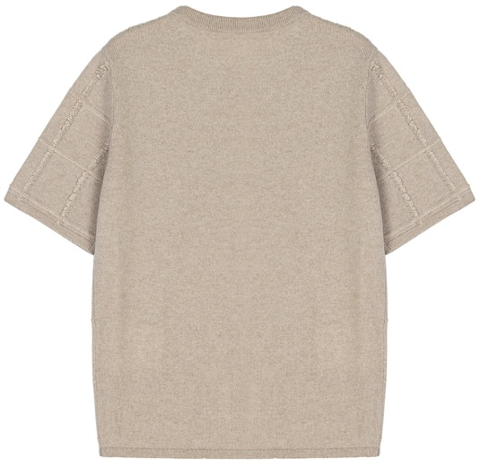
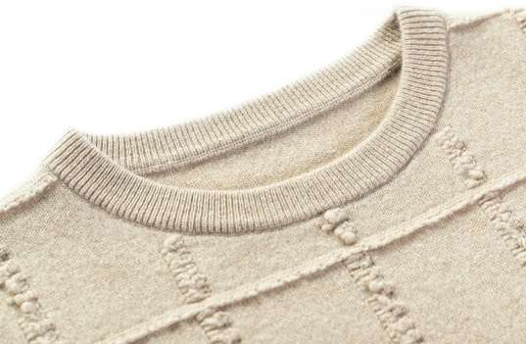
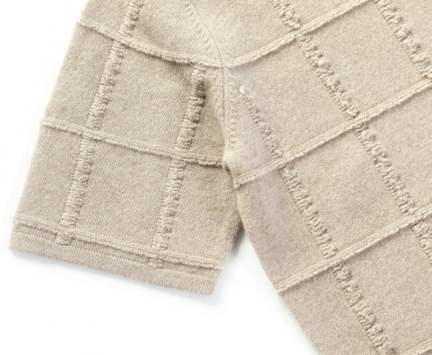
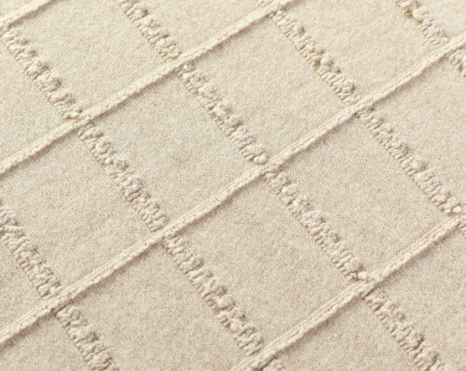
NEEDLES & STITCHES
Gauge:12GG
Yarn: 2/26 70%WOOL 12%NYLON 10%LYOCELL 8%CASHMERE
Weight:175g
STYLE NO：21089

Slide 9
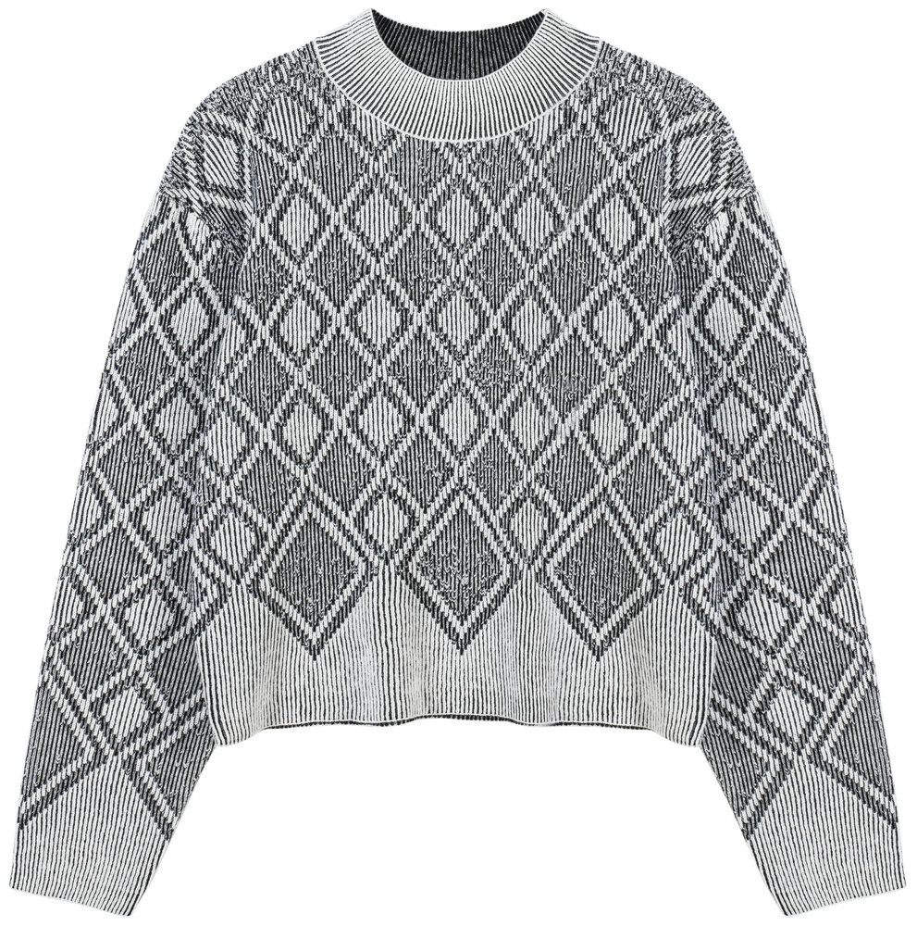
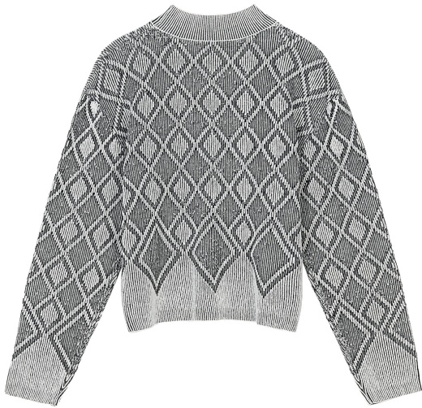
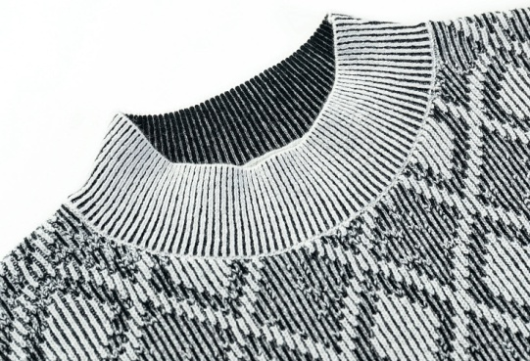
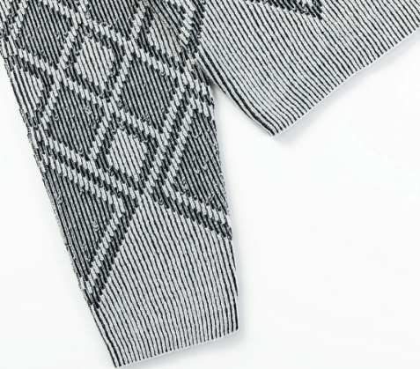
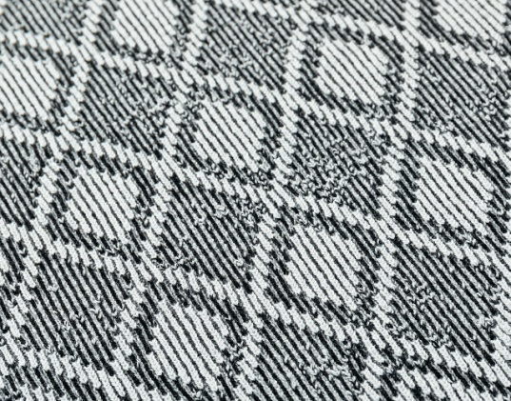
NEEDLES & STITCHES
Gauge:12GG
Yarn: 2/26 100% WOOL
+2/26 90%WOOL 10%CASHMERE
Weight:301g
STYLE NO：21102

Slide 10
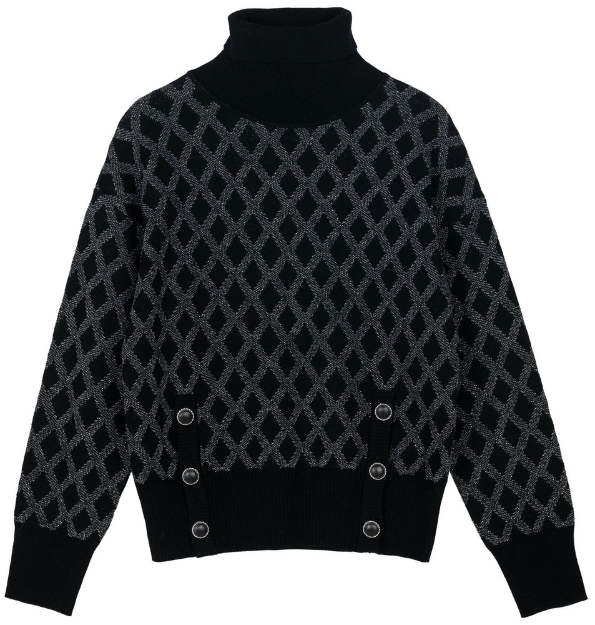
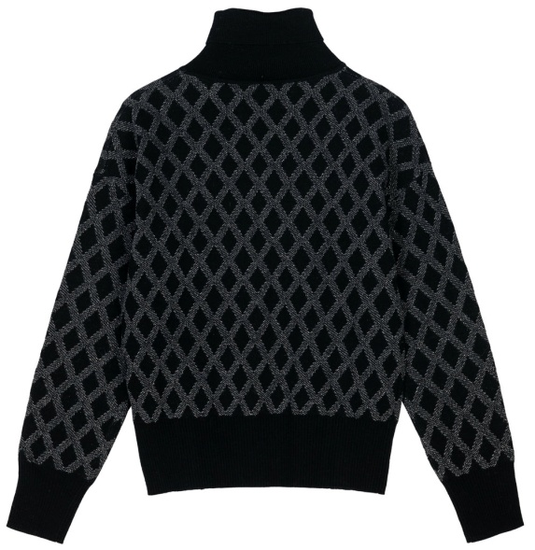
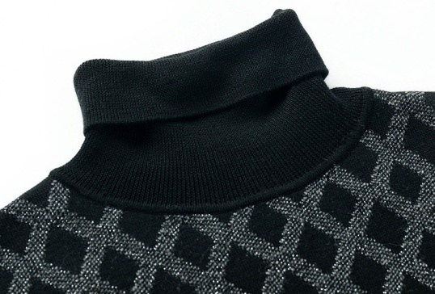
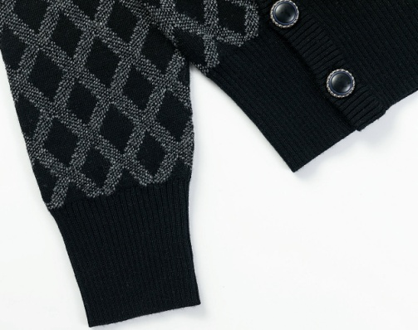
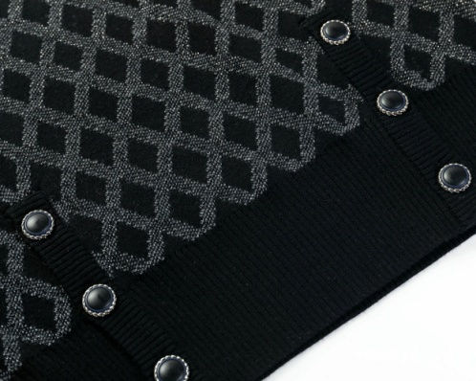
NEEDLES & STITCHES
Gauge:12GG
Yarn:1/16 100%WOOL
+2/48 100%WOOL
+LUREX
Weight:327g
STYLE NO：21091

Slide 11
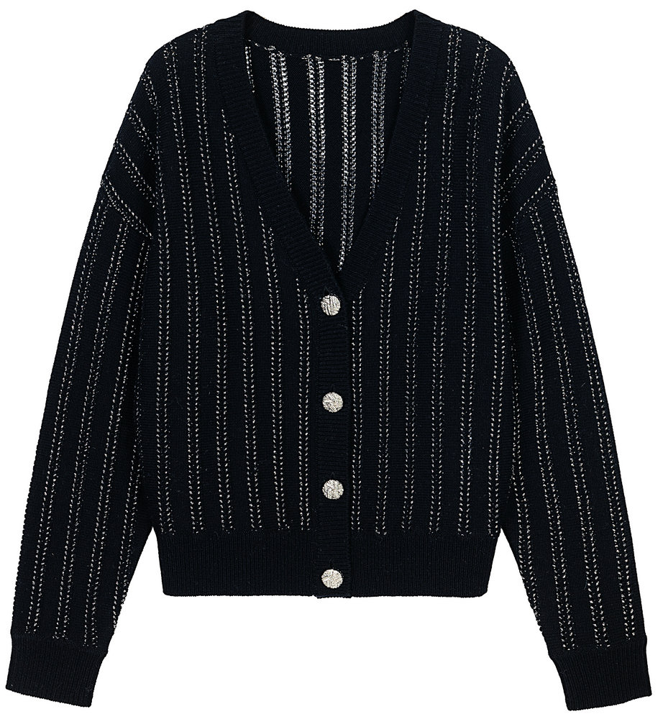
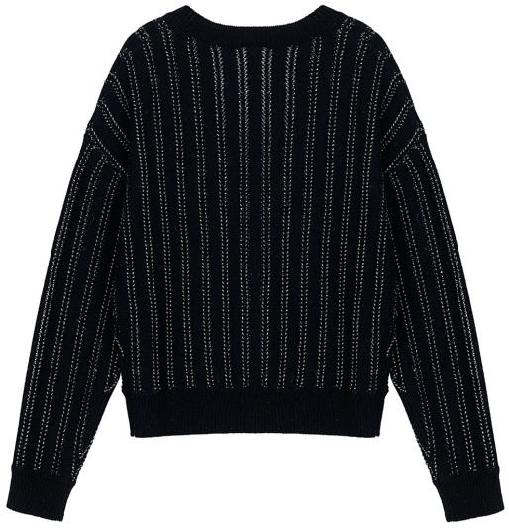
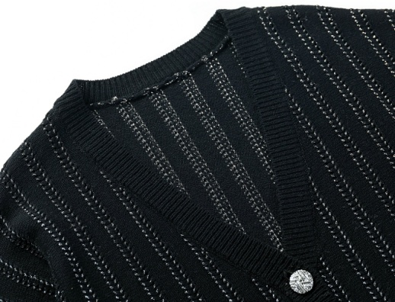
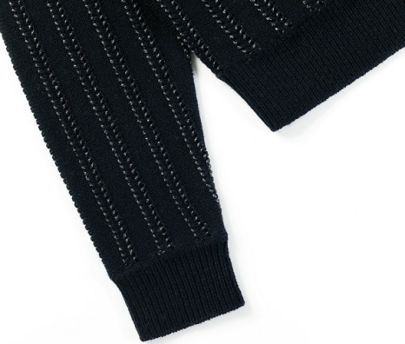
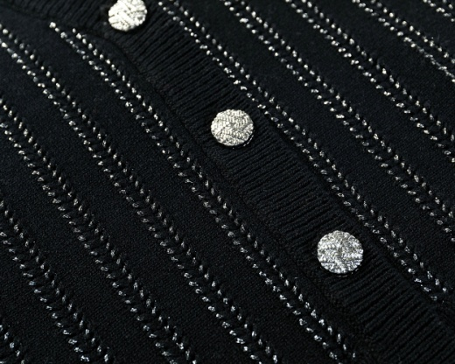
NEEDLES & STITCHES
Gauge:7GG
Yarn:2/26 100%WOOL
+LUREX
Weight:310g
STYLE NO：21123

